Slide 1
Summer Progress Report: Trigger Efficiency Analysis
ICARUS Data-Driven Trigger Efficiency Measurement
Tanvi Krishnan
Mentor: Gianluca Petrillo
SLAC SULI Intern 2022

Slide 2
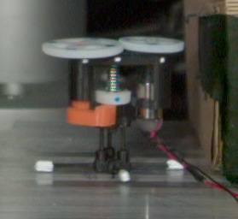


About Me
I’m a rising Junior at Harvey Mudd College
Major: Physics and Computer Science
HSA Concentration: Music
My previous research experience is mostly in robotic biophysics, with a little bit of theoretical particle physics
In my free time, I like to bake and crochet!

Slide 3
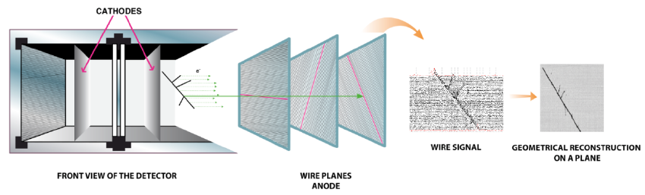
ICARUS
LArTPC with PMTs and 2 cryostats (East and West)
2 TPCs (East and West) in each cryostat (drift volumes, from cathode to anode)
The cathodes are 57% transparent to light
Wire planes at the anode to reconstruct tracks
Rubbia, C & Antonello, M. & Aprili, P. & Baibussinov, B. & Baldo-Ceolin, M. & Barze, Luca & Benetti, P & Calligarich, E & Canci, Nicola & Carbonara, F. & Cavanna, Flavio & Centro, Sandro & Cesana, A & Cieslik, Krzysztof & Cline, D. & Cocco, Alfredo & Dabrowska, Anna & Dequal, Daniele & Dermenev, A & Zmuda, J.. (2011). Underground operation of the ICARUS T600 LAr-TPC: first results. Journal of Instrumentation - J INSTRUM. 6. 10.1088/1748-0221/6/07/P07011

Slide 4
Motivation
The ICARUS detector generates hundreds of terabytes of data daily
The trigger system filters and keeps only potentially interesting events, reducing the amount of data storage required
Trigger logic is based on the collected scintillation light by the PMTs
Majority is the number of PMT pairs above a set threshold
It is important to study the efficiency of the trigger in order to select the optimal level of filtering for the trigger
We plotted the efficiency as a function of different track characteristics (length, starting and ending x coordinate, starting z coordinate)
We plotted the efficiency under different emulated trigger settings:
M1: 1 PMT pair trigger S3: 3 PMT pairs trigger
S5: 5 PMT pairs trigger S8: 8 PMT pairs trigger
S10: 10 PMT pairs trigger S15: 15 PMT pairs trigger
We use a trigger emulation with a minimum bias run (without the hardware trigger running) so that we have an unbiased sample to analyze with different thresholds

Slide 5
Goals
Cathode-Crossing Tracks
These are currently the only tracks for which we can reconstruct the time of the track (t0), so the only tracks that we can match to the corresponding PMT flashes and emulate the trigger performance for.
Recreate efficiency plot v. track length by J. Zettlemoyer
Explore trigger efficiency as a function of other variables
CRT-matched tracks
Explore trigger efficiency for a larger variety of tracks (less restrictive sample)
The CRT (cosmic ray tagger) is on the outside of the detector, and when we combine the data it collects with the data from the TPCs we can reconstruct the times of tracks that did not cross the cathode. This allows us to analyze a more general sample.
This sample is not yet ready, so I have been working with the cathode-crossing track data so far

Slide 6
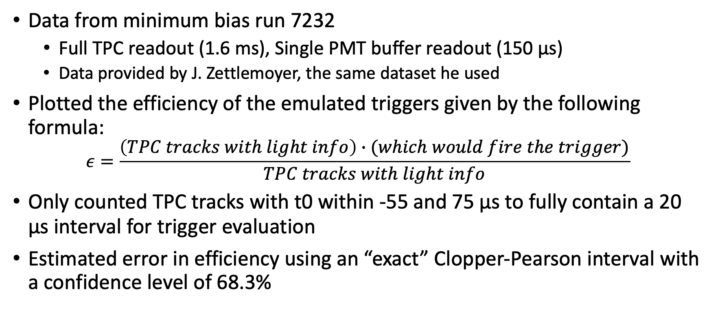
Methods
Data from minimum bias run 7232
Full TPC readout (1.6 ms), Single PMT buffer readout (150 µs)
Data provided by J. Zettlemoyer, the same dataset he used
Plotted the efficiency of the emulated triggers given by the following formula:
$$ε=\frac{\left(TPC tracks with light info\right)∙(which would fire the trigger)}{TPC tracks with light info}$$
Only counted TPC tracks with t0 within -55 and 75 µs to fully contain a 20 µs interval for trigger evaluation
Estimated error in efficiency using an “exact” Clopper-Pearson interval with a confidence level of 68.3%

Slide 7
Efficiency Plots
Using reconstructed cathode-crossing tracks from a minimum-bias data run with different trigger emulations, comparing East and West cryostats

Slide 8
Track length
There were very few (<0.05%) tracks longer than 1000 cm, so I focused on tracks shorter than 1000 cm
Longer tracks have more energy and so we detect more light from them, so they’re easier to trigger
Cosmic muons are usually long but muons from neutrino events are not necessarily so

Slide 9
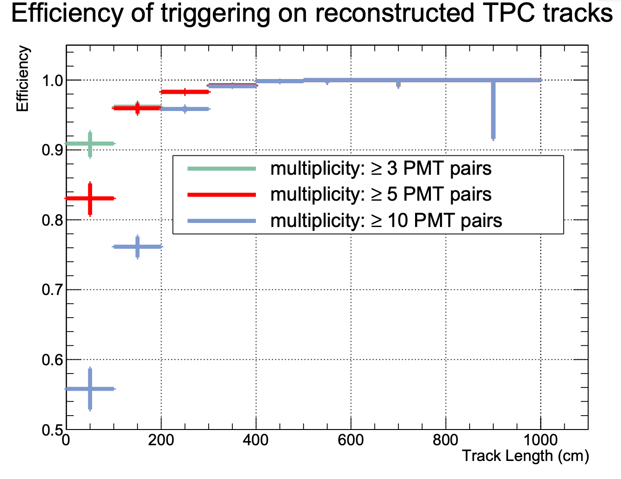
Track length
Recreated plot of trigger efficiencies by Jacob Zettlemoyer
Notes:
It appears that he used the data from the West cryostat, which matches well albeit slight variations in the magnitude of the error bars, as he probably used a different method for these calculations

Slide 10
Track length
In both cryostats there’s a drop in efficiency of the emulated triggers for track lengths around 200-240 cm

Slide 11
Starting z-position of tracks
The efficiency appears to have 3 peaks at the centers of the 3 sections of each cryostat (in the trigger emulation) along the z-axis
Sliding window setup should fix this
Notes:
Starting z-position varied from about -900 cm to 900 cm and appears to be roughly evenly distributed
The sliding window setup should eliminate this issue.

Slide 12
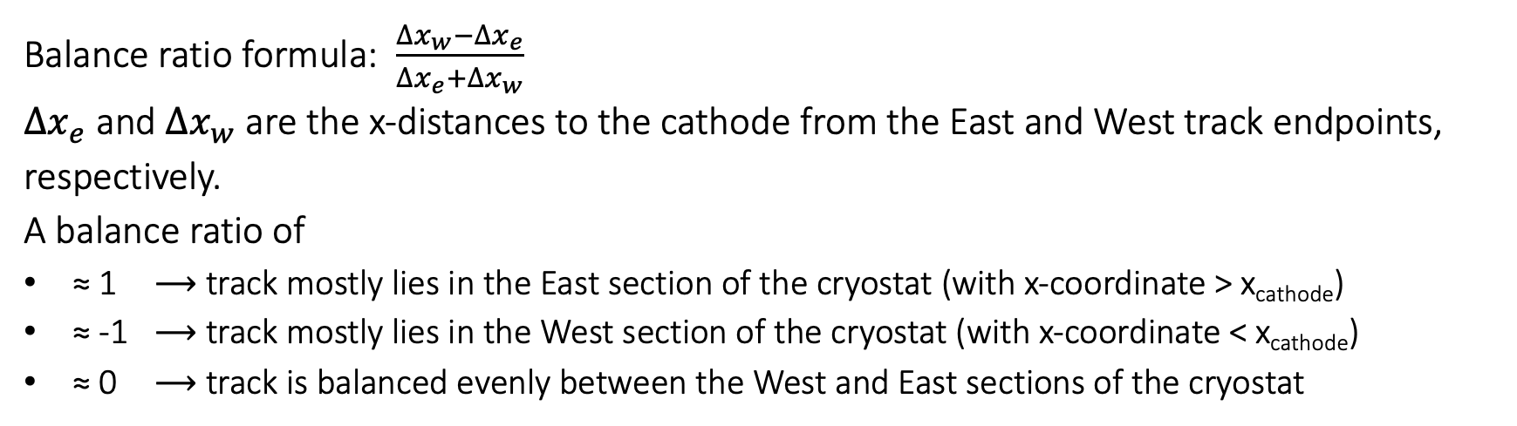
X-directional balance of tracks on either side of the cathode
Δx_{e}
Δx_{e}
> 90% East
Ratio ≈ 1
Δx_{w}
Δx_{e}
> 90% West
Ratio ≈ -1
Δx_{w}
Δx_{w}
Balance ratio formula: $\frac{∆x_{w}−∆x_{e}}{∆x_{e}+∆x_{w}}$
$∆x_{e}$ and $∆x_{w}$ are the x-distances to the cathode from the East and West track endpoints, respectively.
A balance ratio of
≈ 1 ⟶ track mostly lies in the East section of the cryostat (with x-coordinate > x_{cathode})
≈ -1 ⟶ track mostly lies in the West section of the cryostat (with x-coordinate < x_{cathode})
≈ 0 ⟶ track is balanced evenly between the West and East sections of the cryostat
Notes:
Explain we want to know which side deposited energy on – don’t have that
Want track trajectories – don’t have that
This is the best proxy

Slide 13
X-position of the cathode
”start” and “end” label assigned by TPC pattern recognition (Pandora)
Cathodes are at x=-210 cm and x=210 cm
East Cryostat
West Cryostat
Notes:
There was a sharp drop in the number of tracks that start and end at x=210 cm for the West cryostat and x=-210 cm for the East cryostat which indicates that this is the x-position of the cathode

Slide 14
X-directional balance of tracks on either side of the cathode
Balance Ratio | ≈ -1 | ≈ 0 | ≈ 1
Primary TPC of Track | East | Both | West
Notes:
Transpose table, -1, 0, 1

Slide 15
X-distance to Cathode from farther endpoint for tracks primarily on one side of the cathode
These plots describe tracks with a balance ratio more extreme than 0.9.
East of Cathode
West of Cathode
East Cryostat
88 tracks
459 tracks
West Cryostat
472 tracks
530 tracks

Slide 16
Distance to Cathode from farther endpoint for tracks primarily on one side of the cathode
These plots describe tracks with a balance ratio more extreme than 0.9.
East Cryostat
East of Cathode
West of Cathode

Slide 17
Distance to Cathode from farther endpoint for tracks primarily on one side of the cathode
These plots describe tracks with a balance ratio more extreme than 0.9.
West Cryostat
East of Cathode
West of Cathode

Slide 18
Conclusion/next steps
CRT sample not ready yet
Balance ratio is meant to be a measure of the difference in energy deposition of a track on both sides of the cathode, since we are missing the necessary information in the tree to get a better estimate
We are looking to see if we could get this information added to the tree
It would be helpful to add trigger emulation with sliding windows
This would eliminate the drop in efficiency seen with the starting z-position plots
The East cryostat and East TPC looked/behaved differently
Much fewer tracks primarily in the East TPC of the East cryostat, and a ~10% drop in efficiency
Larger drop in efficiency in the East cryostat for track lengths between 200 – 240 cm
Performance differences could be a result of TPC variation on the sides, not only the PMT performance.

Slide 19
Additional Slides

Slide 20
Time Difference between nominal trigger and beam gate
Time difference has 5 possible values, spaced 8 ns apart, from 120 ns to 152 ns. The mean time difference between nominal trigger and beam gate is 138.2 ns. This time difference is due to hardware delays.

Slide 21
Track-Flash Matching Algorithms
Matching tracks and flashes within a single PMT readout window using location-based and time-based algorithms and comparing the results

Slide 22
Two matching algorithms: location and time based
Location Based Algorithm
Pick the flash that’s closest in y-z position to the track’s barycenter/midpoint
Time Based Algorithm
This method
Pick the flash that’s closest in time to the track time (t0)
Keep only tracks with flashes within (t0-40 µs, t0+20 µs)
From location-based matching, we found most matched tracks were within this range
Both Algorithms
Allow multiple tracks to match to the same flash
Only consider tracks within the PMT readout window, t0 within (-55 µs, 75 µs)
This is in order to ensure that we should have the corresponding flash recorded

Slide 23
Matching by Barycenter of Flashes and Tracks
Pick the flash whose location is closest to the midpoint of the corresponding track
Below is plotted the time difference between the flash and its matched track

Slide 24
Exploration: Location of Tracks
We checked whether it makes a significant difference to use the start, end, or midpoint of the track as the track’s location
“start” and “end” label assigned by TPC pattern recognition (Pandora)
Midpoint/barycenter of track calculated using these start and end positions
While there were slight variations, it didn’t significantly affect the plot
Start
Barycenter
End
Notes:
As func of track length in terms of z? x-axis – (start_z – end_z)*abs (2m bins), y-axis – peak and errorbars (left width, right width)
3 colors – one for start, midpoint, and end? Or remove error bars and plot separately?
3 separate or side-by-side plots?

Slide 25
Time Difference between flash and emulated trigger
We used time-based flash-track matching for this
We expect this to mostly be 0, and we do see a large spike at 0
There are more tracks slightly below 0 than slightly above, so there are more tracks where the flash is slightly before than the emulated trigger than tracks where the flash is slightly after
In this plot, the time of the flash is already biased by our matching algorithm

Slide 26
Matching by Time of Flashes and Tracks
Pick the flash whose time is closest to the corresponding track and within (t0-40 µs, t0+20 µs)
We chose this based on the width of the time difference peak when tracks and flashes were matched by time
Below is plotted distance between flashes and midpoints of tracks
Notes:
Replace!!

Slide 27
Time Difference between flash and emulated trigger
We used location-based flash-track matching for this
We expect this to mostly be 0, and we do see a large spike at 0
There are more tracks slightly above 0 than slightly below, so there are more tracks where the flash is slightly later than the emulated trigger than tracks where the flash is slightly before

Slide 28
Time Difference between emulated trigger and t0 (track time)
The time difference should not be negative – this shift is an artifact of the reconstruction
The wide peak is the average time delay between the track and the trigger
There is also a peak at -20 µs. We used an interval from t₀ – 20 µs to t₀ to evaluate the trigger response, so any residual light from events before the start of the interval could activate the trigger response immediately upon the start of that interval, as the trigger can only be activated once per spill. This causes the initial spike that can be seen at -20 µs.

Slide 29
Distribution of flashes is not uniform - it is concentrated close to where the PMTs are located
Y-Z positions of flashes in both cryostats

Slide 30
Y-Z Positions of Tracks
It appears that using the midpoint of position of the track as a measure of the track’s location is the most unbiased way to compare it to the flash position, which has a similar distribution

Slide 31
Distance between track and flash peaks at 0-20 cm with a smaller peak at 50-80 cm. We don’t fully understand what is causing this second peak, but it is independent of the z-position of the flash.
Distance Between track and Flash as a function of z-position of flash

Slide 32
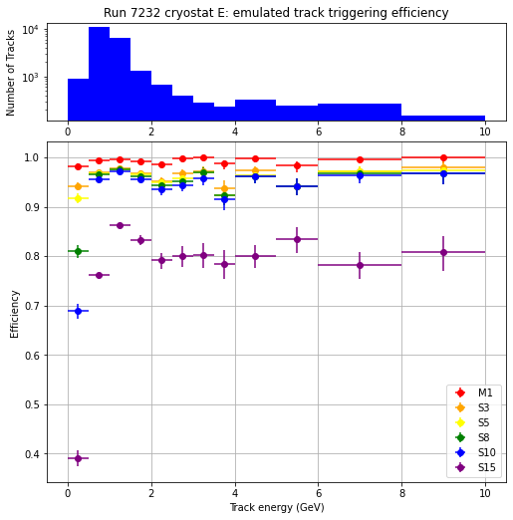
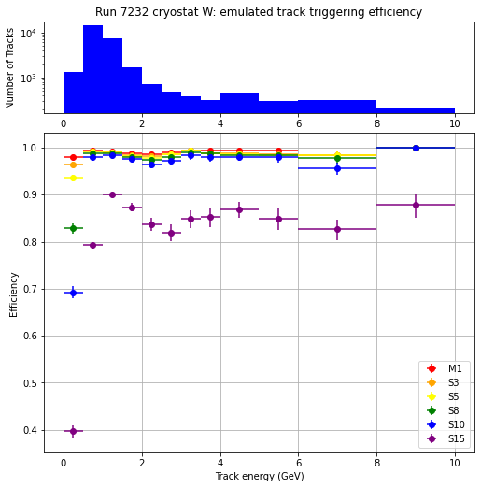
Varying track energy
Reconstructed track energies varied from 37 MeV to 1.4 TeV, but there were very few (<2%) tracks with more than 10 GeV of energy, so I focused on tracks with less than 10 GeV of energy
Notes:
Where does energy algorithm come from? Might not be meaningful

Slide 33
Varying track length for tracks primarily on one side of the cathode or the other
These plots describe tracks with a balance ratio more extreme than 0.9 and use a 68.27% Confidence interval.
East Cryostat
West Cryostat
Notes:
Write how many tracks
Vs other x coordinate?
Separate slides for each cryostat

Slide 34
Varying track energy for tracks primarily on one side of the cathode or the other
These plots describe tracks with a balance ratio more extreme than 0.9 and use a 68.27% Confidence interval.
East Cryostat
West Cryostat

